Slide 1


CoB191: Business Analytics I
Chapter 7
Modified and adapted by Ehsan Teymourian
Notes:
Add slide notes here

Slide 2
Analytics
Descriptive Analysis
Predictive Analysis
Prescriptive Analysis
The scientific process of transforming data into insight for making better decisions.
(COB191: Ch.1-3)
Inferential Statistics
(COB191: Ch.7-9),
Lin Reg, Queueing Sys,
and Forecasting (COB291)
Decision Analysis, Optimization, etc. (COB291)

Slide 3
Chapter 7 Sampling and Sampling Distributions
Selecting a Sample
Point Estimation
Introduction to Sampling Distributions
Sampling Distribution of
Sampling Distribution of

Slide 4
Introduction (1 of 2)
An element is the entity on which data are collected.
A population is a collection of all the elements of interest.
A sample is a subset of the population.
The sampled population is the population from which the sample is drawn.
A frame is a list of the elements that the sample will be selected from.

Slide 5
Introduction (2 of 2)
The reason we select a sample is to collect data to answer a research question about a population.
The sample results provide only estimates of the values of the population characteristics.
The reason is simply that the sample contains only a portion of the population.
With proper sampling methods, the sample results can provide “good” estimates of the population characteristics.

Slide 6
Selecting a Sample
Sampling from a Finite Population
Sampling from an Infinite Population

Slide 7
Sampling from a Finite Population (1 of 4)
Finite populations are often defined by lists such as:
Organization membership roster
Credit card account numbers
Inventory product numbers
A simple random sample of size n from a finite population of size N is a sample selected such that each possible sample of size n has the same probability of being selected.

Slide 8
Sampling from a Finite Population (2 of 4)
In large sampling projects, computer-generated random numbers are often used to automate the sample selection process.

Slide 9
Sampling from a Finite Population (3 of 4)
Example: National Baseball League teams
There are 15 teams that played in the 2019 National Baseball League. Suppose we want to select a simple random sample of 5 teams to conduct in-depth interviews about how they manage their minor legal franchises.

Slide 10
Sampling from a Finite Population (4 of 4)
Example: National Baseball League teams
Step 1: Assign a random number to each of the 15 teams in the population.
The random numbers generated by Excel’s RAND function follow a uniform probability distribution between 0 and 1.
Step 2: Select the five teams corresponding to the 5 smallest random numbers as the sample.

Slide 11
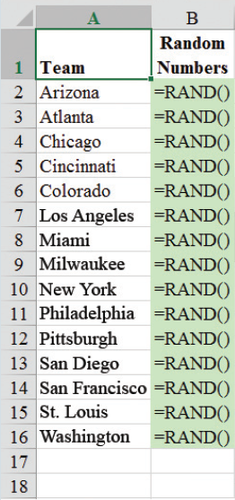
Sampling from a Finite Population Using Excel (1 of 4)
Excel Formula Worksheet

Slide 12
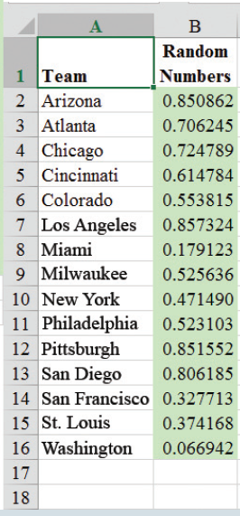
Sampling from a Finite Population Using Excel (2 of 4)
Excel Value Worksheet

Slide 13
Sampling from Finite Population Using Excel (3 of 4)
Use Excel’s sort procedure to select the five teams corresponding to the five smallest random numbers.
Steps:
Select any cell in the range B2:B16
Click on Home tab on the Ribbon
In the Editing group click Sort & Filter
Choose Sort smallest to largest

Slide 14
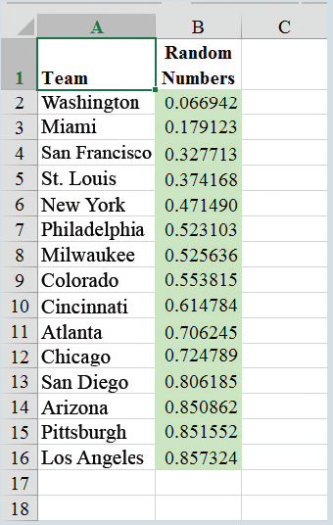
Sampling from Finite Population Using Excel (4 of 4)
Excel Value Sheet (Sorted)

Slide 15
Sampling from an Infinite Population (1 of 3)
Sometimes we want to select a sample but find it is not possible to obtain a list of all elements in the population.
As a result, we cannot construct a frame for the population.
Hence, we cannot use the random number selection procedure.
Most often this situation occurs in infinite population cases.

Slide 16
Sampling from an Infinite Population (2 of 3)
Populations are often generated by an ongoing process where there is no upper limit on the number of units that can be generated.
Some examples of on-going processes, with infinite populations, are:
Parts being manufactured on a production line
Transactions occurring at a bank
Telephone calls arriving at a technical help desk
Customers entering a store

Slide 17
Sampling from an Infinite Population (3 of 3)
In the case of an infinite population, we must select a random sample in order to make valid statistical inferences about the population from which the sample is taken.
A random sample from an infinite population is a sample selected such that the following conditions are satisfied.
Each element selected comes from the population of interest.
Each element is selected independently.

Slide 18
Practical Advice
The target population is the population we want to make inferences about.
The sampled population is the population from which the sample is actually taken.
Whenever a sample is used to make inferences about a population, we should make sure that the targeted population and the sampled population are in close agreement.

Slide 19
Other Sampling Methods
Please study the “Sampling Methods & Errors.docx”
under Modules/Week X (Ch.7)
Stratified Random Sampling
Cluster Sampling
Systematic Sampling
Convenience Sampling
Judgment Sampling

Slide 20
Point Estimation (1 of 5)
Point estimation is a form of statistical inference.
In point estimation we use the data from the sample to compute a value of a sample statistic that serves as an estimate of a population parameter.
We refer to
as the point estimator of the population mean µ.
s is the point estimator of the population standard deviation σ.
is the point estimator of the population proportion p.

Slide 21
Point Estimation (2 of 5)
Example: EAI Employee Data
Out of a total number of 2,500 employees, a simple random sample of 30 employees and corresponding data on annual salary and management training program participation are shown in the given table. x_{1,} x_{2 …..} x_{n} is used to denote annual salary of the employees, and the participation in the management training program is indicated by a yes / no.

Slide 22
Point Estimation (3 of 5)
Annual Salary ($) | Management Training Program | Annual Salary ($) | Management Training Program | Annual Salary ($) | Management Training Program
x₁ ₌ 69094.30 | YES | 65,922.60 | YES | 65,120.90 | YES
x₂ ₌ 73263.90 | YES | 77,268.40 | NO | 71,753.00 | YES
x₃ ₌ 69,643.50 | YES | 75,688.40 | YES | 74,391.80 | NO
69,894.90 | YES | 71,564.70 | NO | 70,164.20 | NO
67,621.60 | NO | 76,188.20 | NO | 72,973.60 | NO
75,924.00 | YES | 71,766.00 | YES | 70,241.30 | NO
69,092.30 | YES | 72,541.30 | NO | 72,793.90 | NO
71,404.40 | YES | 64980.00 | YES | 70,979.40 | YES
70,957.70 | YES | 71,932.60 | YES | x₂₉ ₌ 75,860.90 | YES
75,109.70 | YES | 72,973.00 | YES | x₃₀ ₌ 77,309.10 | NO

Slide 23
Point Estimation (4 of 5)
To estimate the value of population parameter, we can compute the corresponding characteristic of the sample, referred to as a sample statistic.
Note: Different random numbers will identify different sample which would result different point estimates.

Slide 24
Point Estimation (5 of 5)
Example: EAI Employee Data
as Point Estimator of µ
s as Point Estimator of σ
as Point Estimator of p

Slide 25
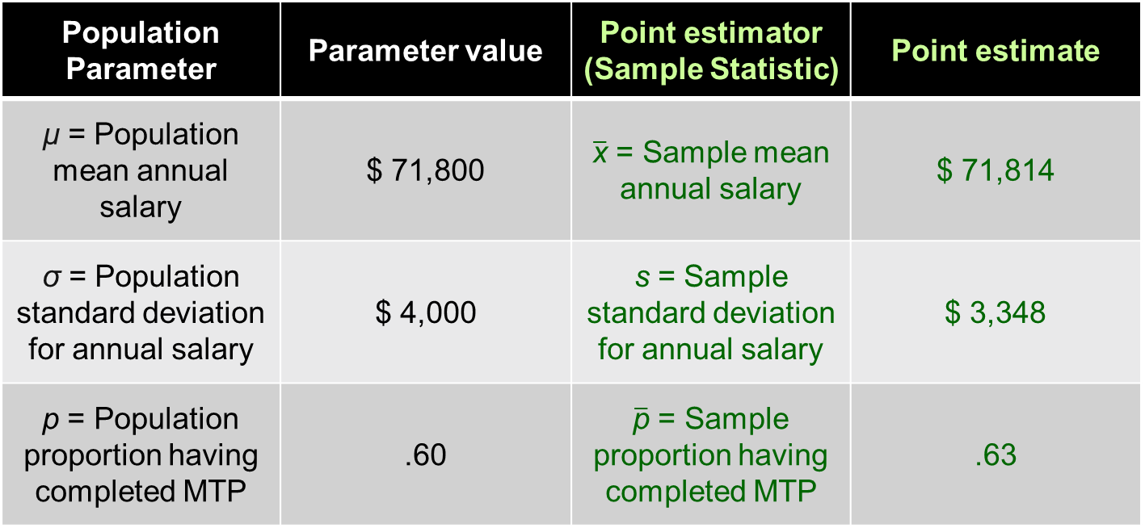
Summary of Point Estimates Obtained from a Simple Random Sample
Population Parameter | Parameter value | Point estimator (Sample Statistic) | Point estimate
µ = Population mean annual salary | $ 71,800 | $\overline{\text{x}}$ = Sample mean annual salary | $ 71,814
σ = Population standard deviation for annual salary | $ 4,000 | s = Sample standard deviation for annual salary | $ 3,348
p = Population proportion having completed MTP | .60 | $\overline{\text{p}}$ = Sample proportion having completed MTP | .63

Slide 26
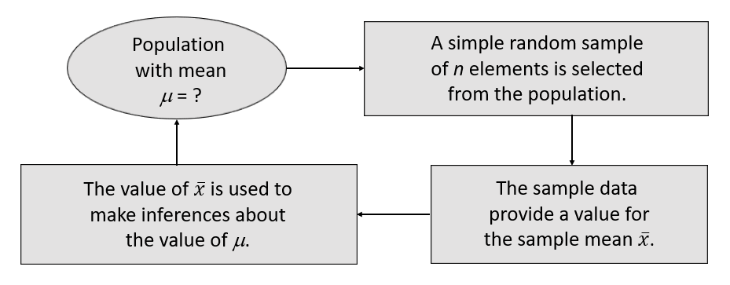

Sampling Distribution of $\overline{\text{x}}$ (1 of 13)
Process of Statistical Inference

Slide 27

Sampling Distribution of $\overline{\text{x}}$ (2 of 13)
The sampling distribution of__
is the probability distribution of all possible values of the sample mean
Expected Value of
where: µ = the population mean
When the expected value of the point estimator equals the population parameter, we say the point estimator is unbiased.

Slide 28

Sampling Distribution of $\overline{\text{x}}$ (3 of 13)
We will use the following notations to define the standard deviation of the sampling distribution of

Slide 29

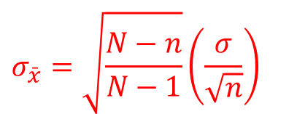
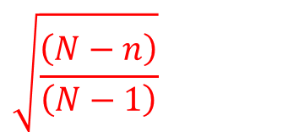
Sampling Distribution of $\overline{\text{x}}$ (4 of 13)
Standard Deviation of
Finite Population
Infinite Population
$$σ_{\bar{x}}=\sqrt{\frac{N−n}{N−1}}\left(\frac{σ}{\sqrt{n}}\right)$$
A finite population is treated as being infinite if
$$\sqrt{\frac{\left(N−n\right)}{\left(N−1\right)}}$$
is the finite population correction factor.
is referred to as the standard error of the mean.

Slide 30

Sampling Distribution of $\overline{\text{x}}$(5 of 13)
When the population has a normal distribution, the sampling distribution of
is normally distributed for any sample size.
In most applications, the sampling distribution of
can be approximated by a normal distribution whenever the sample is size 30 or more.
In cases where the population is highly skewed or outliers are present, samples of size 50 may be needed.

Slide 31

Sampling Distribution of $\overline{\text{x}}$ (6 of 13)
The sampling distribution of
can be used to provide probability information about how close the sample mean
is to the population mean µ.

Slide 32
Central Limit Theorem
When the population from which we are selecting a random sample does not have a normal distribution, the central limit theorem is helpful in identifying the shape of the sampling distribution of
CENTRAL LIMIT THEOREM
In selecting random samples of size n from a population, the sampling distribution of the sample mean
can be approximated by a normal distribution as the sample size becomes large.

Slide 33
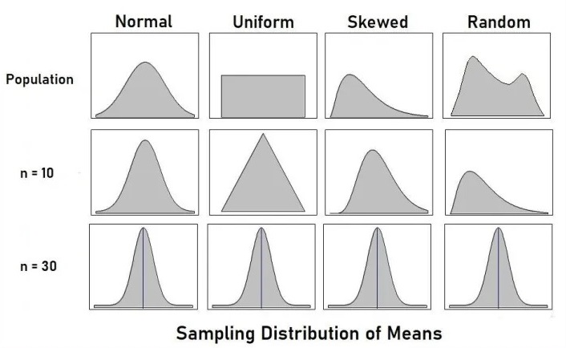
Central Limit Theorem

Slide 34
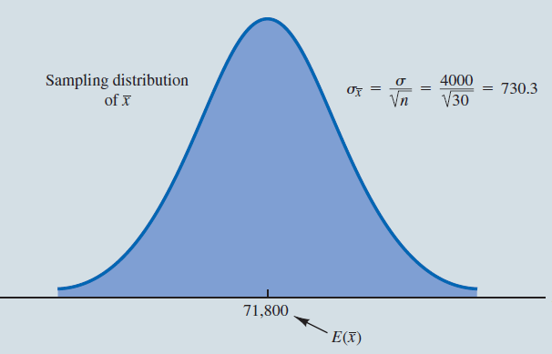

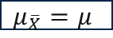
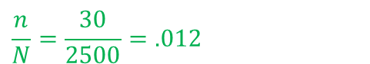
Sampling Distribution of $\overline{\text{x}}$ (7 of 13)
Example: EAI Employee Data
Note:
$$\frac{n}{N}=\frac{30}{2500}=.012$$
Because the sample is less than 5% of the population size, we ignore the finite population correction factor.
$$μ_{\overline{X}}=μ$$

Slide 35
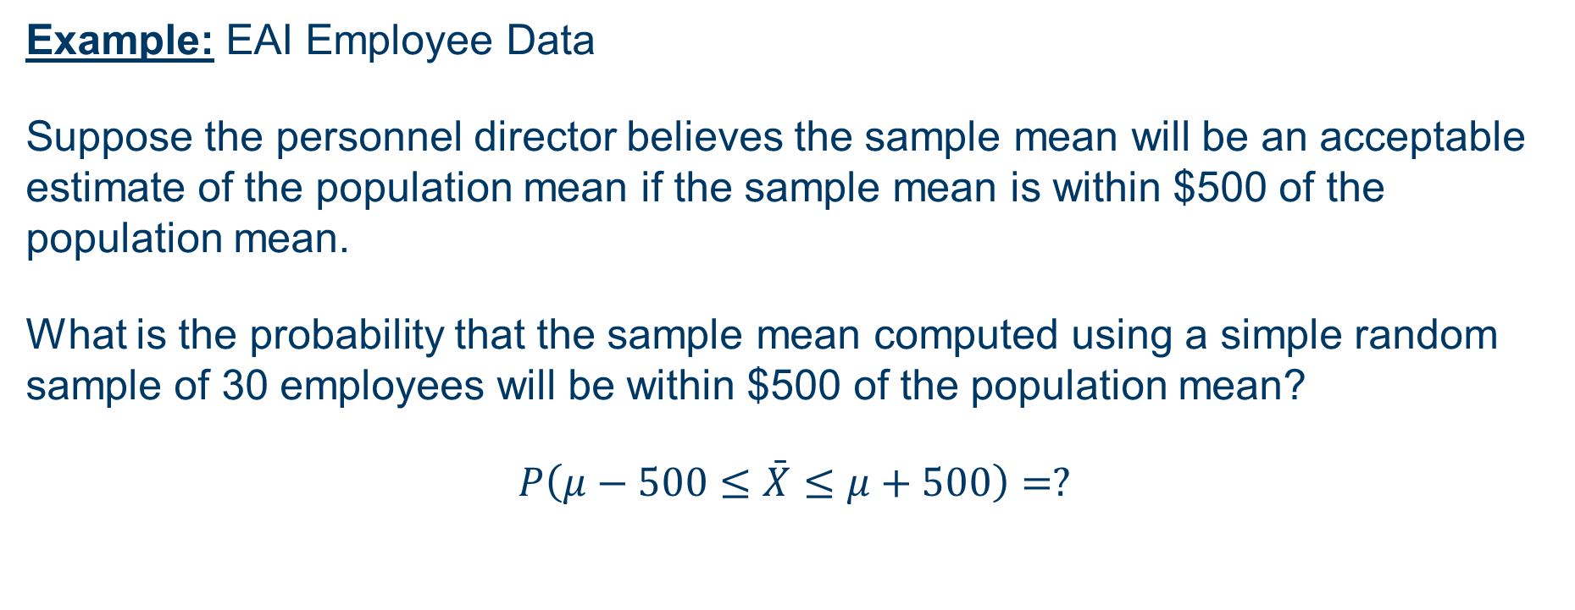

Sampling Distribution of $\overline{\text{x}}$ (8 of 13)
Example: EAI Employee Data
Suppose the personnel director believes the sample mean will be an acceptable estimate of the population mean if the sample mean is within $500 of the population mean.
What is the probability that the sample mean computed using a simple random sample of 30 employees will be within $500 of the population mean?
$P\left(μ−500≤\bar{X}≤μ+500\right)=?$

Slide 36

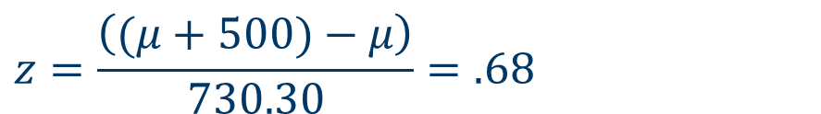
Sampling Distribution of $\overline{\text{x}}$ (9 of 13)
Example: EAI Employee Data
Step 1: Calculate the z-value at the upper endpoint of the interval.
$$z=\frac{\left((μ+500)−μ\right)}{730.30}=.68$$
Step 2: Find the area under the curve to the left of the upper endpoint.

Slide 37

Sampling Distribution of $\overline{\text{x}}$ (10 of 13)
Example: EAI Employee Data
Cumulative Probabilities for the Standard Normal Distribution
Z | .00 | .01 | .02 | .03 | .04 | .05 | .06 | .07 | .08 | .09
. | . | . | . | . | . | . | . | . | . | .
.5 | .6915 | .6950 | .6985 | .7019 | .7054 | .7088 | .7123 | .7157 | .7190 | .7224
.6 | .7257 | .7291 | .7324 | .7357 | .7389 | .7422 | .7454 | 7.486 | .7517 | .7549
.7 | .7580 | .7611 | .7642 | .7673 | .7704 | .7734 | .7764 | .7794 | .7823 | .7852
.8 | .7881 | .7910 | .7939 | .7967 | .7995 | .8023 | .8051 | .8078 | .8106 | .8133
.9 | .8159 | .8186 | .8212 | .8238 | .8264 | .8289 | .8315 | .8340 | .8365 | .8389
. | . | . | . | . | . | . | . | . | . | .

Slide 38

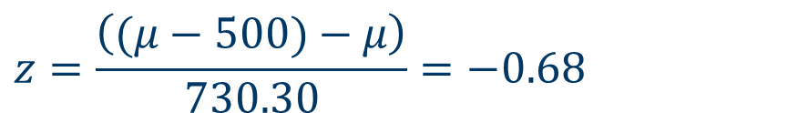
Sampling Distribution of $\overline{\text{x}}$ (11 of 13)
Example: EAI Employee Data
Step 3: Calculate the z-value at the lower endpoint of the interval.
$$z=\frac{\left((μ−500)−μ\right)}{730.30}=−0.68$$
Step 4: Find the area under the curve to the left of the lower endpoint.

Slide 39

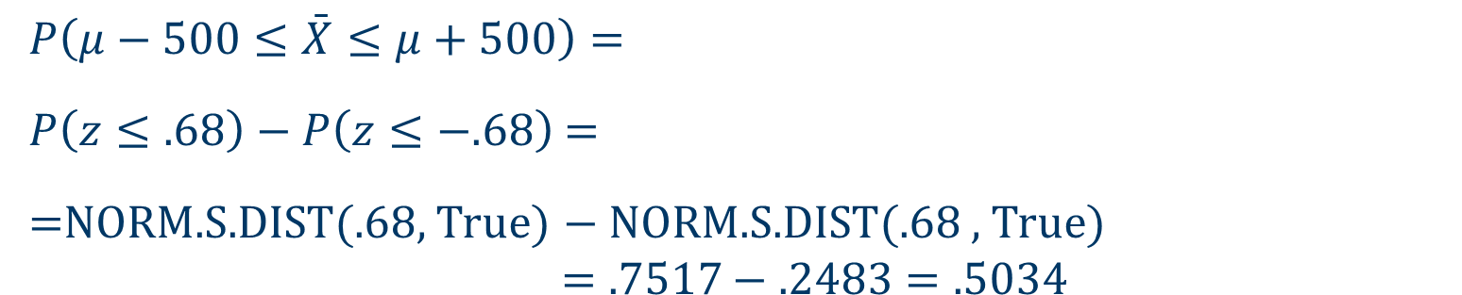
Sampling Distribution of $\overline{\text{x}}$ (12 of 13)
Example: EAI Employee Data
Step 5: Calculate the area under the curve between the lower and upper endpoints of the interval.
$$P\left(μ−500≤\bar{X}≤μ+500\right)=$$
$P\left(z≤.68\right)−P\left(z≤−.68\right)$ =
=NORM.S.DIST(.68, True) $−$ NORM.S.DIST(.68 , True) $$=.7517−.2483=.5034$$

Slide 40
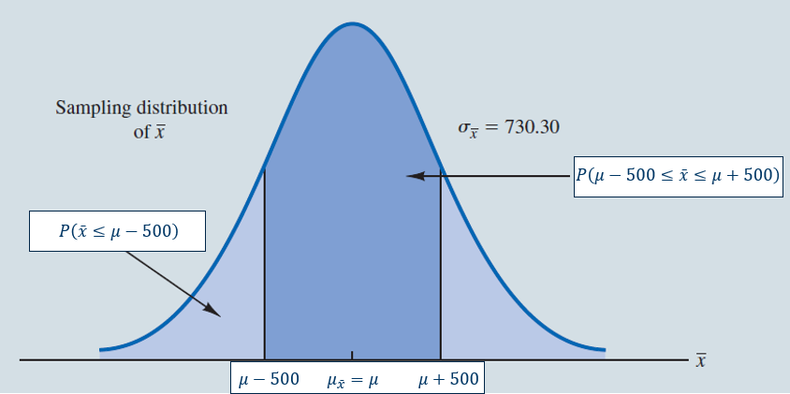

Sampling Distribution of $\overline{\text{x}}$ (13 of 13)
Example: EAI Employee Data

Slide 41
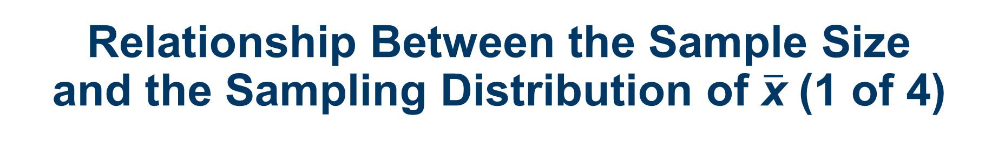
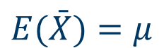
Relationship Between the Sample Size and the Sampling Distribution of $\overline{\text{x}}$ (1 of 4)
Example: EAI Employee Data
Suppose we select a simple random sample of 100 employees instead of the 30 originally considered.
$$E(\bar{X})=μ$$
regardless of the sample size. In our example,
remains at 71,800.
Whenever the sample size is increased, the standard error of the mean
is decreased. With the increase in the sample size to n = 100, the standard error of the mean is decreased from 730.3 to 400.

Slide 42
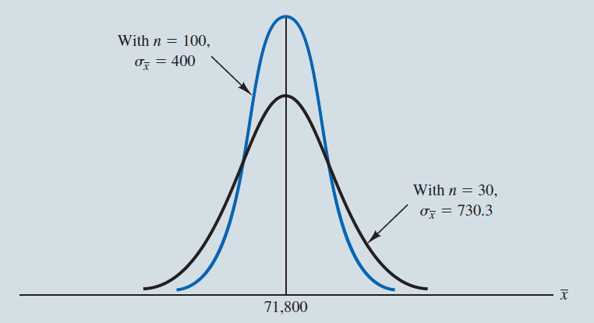
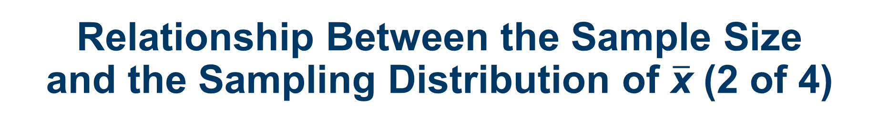
Relationship Between the Sample Size and the Sampling Distribution of $\overline{\text{x}}$ (2 of 4)
Example: EAI Employee Data

Slide 43

Relationship Between the Sample Size and the Sampling Distribution of $\overline{\text{x}}$ (3 of 4)
Example: EAI Employee data
Recall that when
$$n=30\text{, }P(μ−500≤\bar{X}≤μ+500)=.5034$$
Now, using Excel with
$$n=100\text{, }P(μ−500≤\bar{X}≤μ+500)=.7888$$
Because the sampling distribution with
has a smaller standard error, the values of
have less variability and tend to be closer to the population mean than the values of

Slide 44
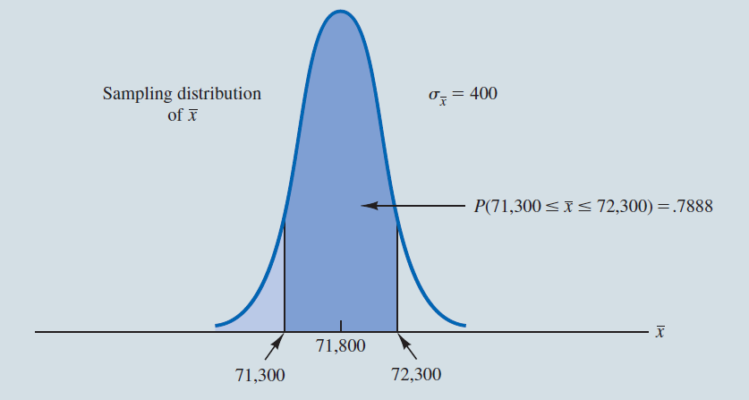
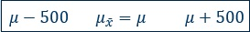

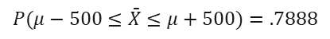
Relationship Between the Sample Size and the Sampling Distribution of $\overline{\text{x}}$ (4 of 4)
Example: EAI Employee Data
$$P(μ−500≤\bar{X}≤μ+500)=.7888$$

Slide 45
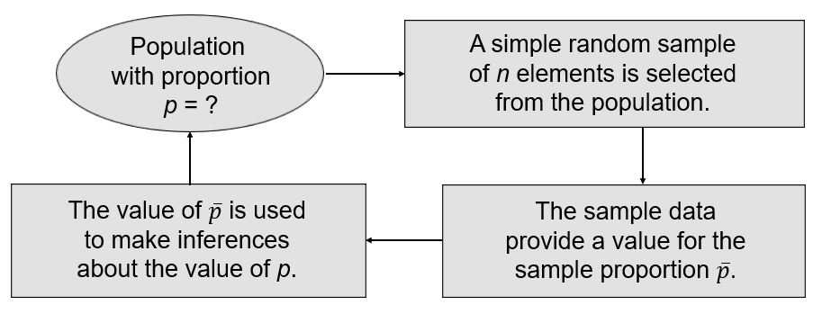

Sampling Distribution of $\overline{\text{p}}$ (1 of 9)
Making inferences about a population proportion

Slide 46


Sampling Distribution of $\overline{\text{p}}$ (2 of 9)
The sampling distribution of__
is the probability distribution of all possible values of the sample proportion
Expected Value of
NOTE: In this class, $\bar{p}$ (or $\hat{p}$) represents a sample proportion,
and $p$ (or $π$) represents a population proportion.

Slide 47

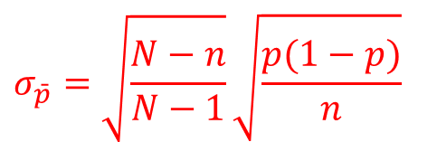
Sampling Distribution of $\overline{\text{p}}$ (3 of 9)
Standard Deviation of
Finite Population
Infinite Population
$$σ_{\bar{p}}=\sqrt{\frac{N−n}{N−1}}\sqrt{\frac{p(1−p)}{n}}$$
is referred to as the standard error of the proportion.

Slide 48

Sampling Distribution of $\overline{\text{p}}$ (4 of 9)
The sampling distribution of
can be approximated by a normal distribution whenever the sample size is large enough to satisfy the two conditions:
When these conditions are satisfied, the probability distribution of x in the sample proportion,
can be approximated by a normal distribution (because n is a constant, the sampling distribution of
can also be approximated by a normal distribution).

Slide 49

Sampling Distribution of $\overline{\text{p}}$ (5 of 9)
Example: EAI Employee Data
For the EAI study we know that the population proportion of employees who participated in the management training program is
What is the probability that a simple random sample of 30 employees will provide an estimate of the population proportion of employees attending management program that is within plus or minus .05 of the actual population proportion?

Slide 50

Sampling Distribution of $\overline{\text{p}}$ (6 of 9)
Example: EAI Employee Data
For our example, with
the normal distribution is an acceptable approximation because:

Slide 51
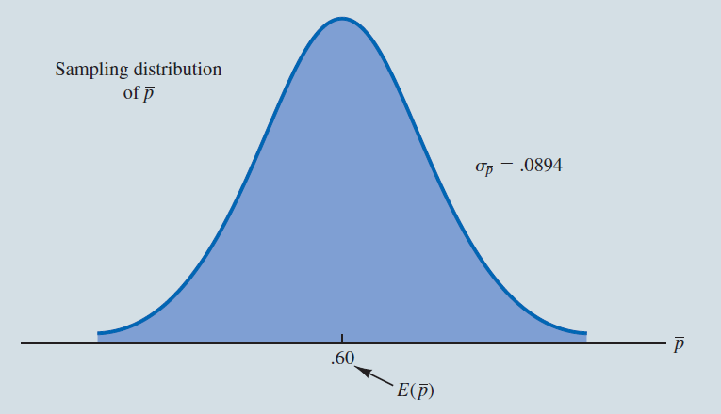

Sampling Distribution of $\overline{\text{p}}$ (7 of 9)
Example: EAI Employee Data

Slide 52

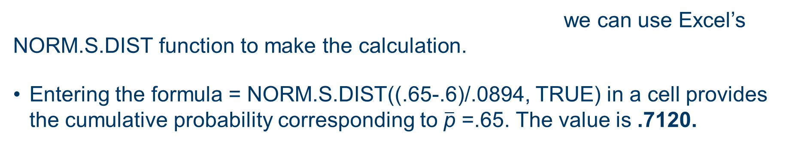
Using Excel for the Sampling Distribution of $\overline{\text{p}}$
Example: EAI Employee Data
Using the mean of .60 and a standard error of
we can use Excel’s NORM.S.DIST function to make the calculation.
Entering the formula = NORM.S.DIST((.65-.6)/.0894, TRUE) in a cell provides the cumulative probability corresponding to $\overline{\text{p}}$ =.65. The value is .7120.

Slide 53

Sampling Distribution of $\overline{\text{p}}$ (8 of 9)
Example: EAI Employee Data
Entering the formula = NORM.S.DIST ((.55-.6)/.0894,TRUE) in a cell provides the cumulative probability corresponding to
The value is .2880.
So, the probability of

Slide 54
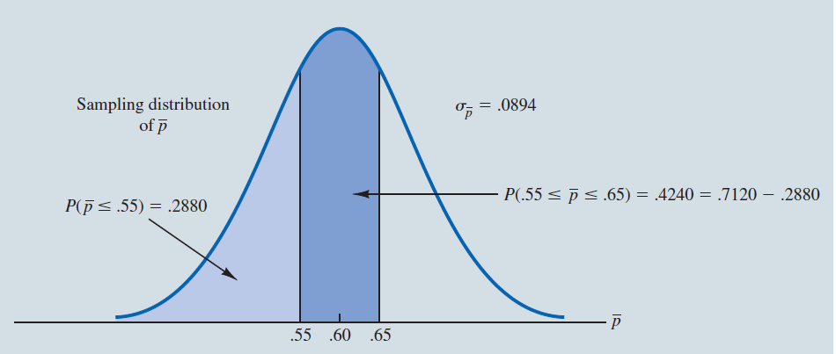

Sampling Distribution of $\overline{\text{p}}$ (9 of 9)
Example: EAI Employee Data

Slide 55
End of Chapter 7

